Slide 1

Access Control
Universal Banking Solution from Infosys

Slide 2
Agenda
Overview of Access Control
Menu Level
- using functional privileges
Record Level
- using Access Matrix
Attribute Level
- using Attribute access

Slide 3
Overview
Access Control can be enabled/disabled in CRMAdmin.
No Access Control in Admin mode.
Access control can be shut down for individual screens.

Slide 4
Entity changes
Added five access control attributes to the following entities
Retail Customer, Retail Contact, Retail Prospect, Retail Non Customer, Corporate, Products, Opportunity, Incidents and Sales
Attributes
Access Owner Group
Access Owner Segment
Access Owner Business Center
Access Owner Agent
Access Assignee Agent

Slide 5
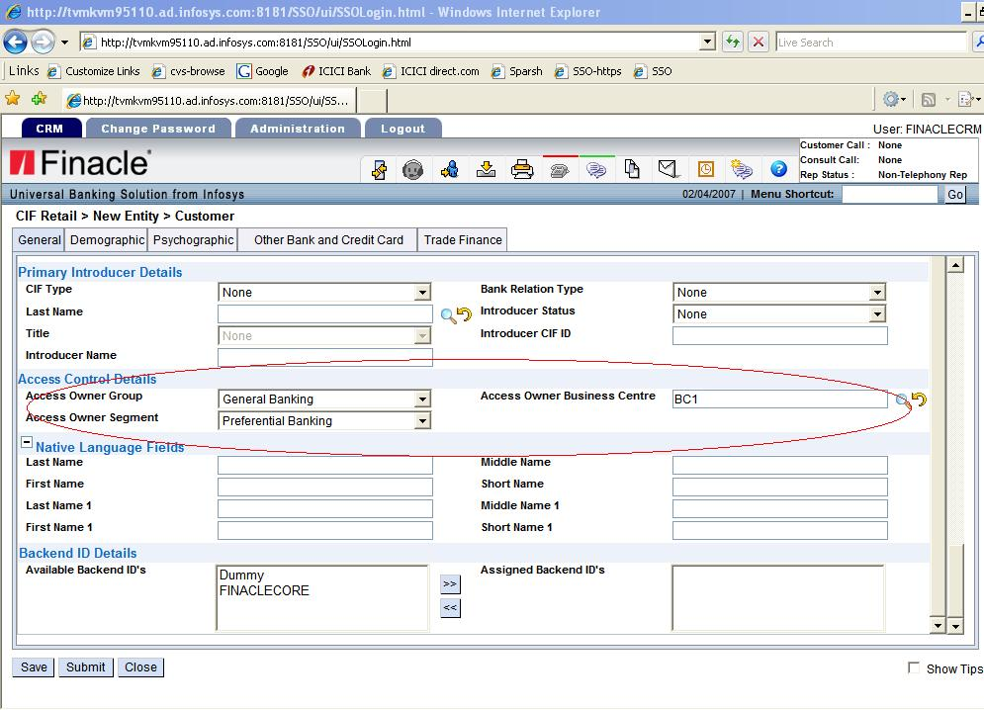

Slide 6

ACCESS CONTROL ATTRIBUTE POPULATION LOGIC

Slide 7
Group Changes
Admin Group
Group
Business Group
User in admin group performs admin activities.
User in a Business group will have controlled access.

Slide 8
User
Primary Group, Primary Role, Primary BC and Primary Segment made mandatory in user creation screen.
RCL option added in User listing to show the access summary of a user.

Slide 9
User
Biz Group
Role
Admin Group
User
Biz Center
Segment

Slide 10
Agent Group Manager
User can belong to multiple group.
User can have only one role in a group.

Slide 11
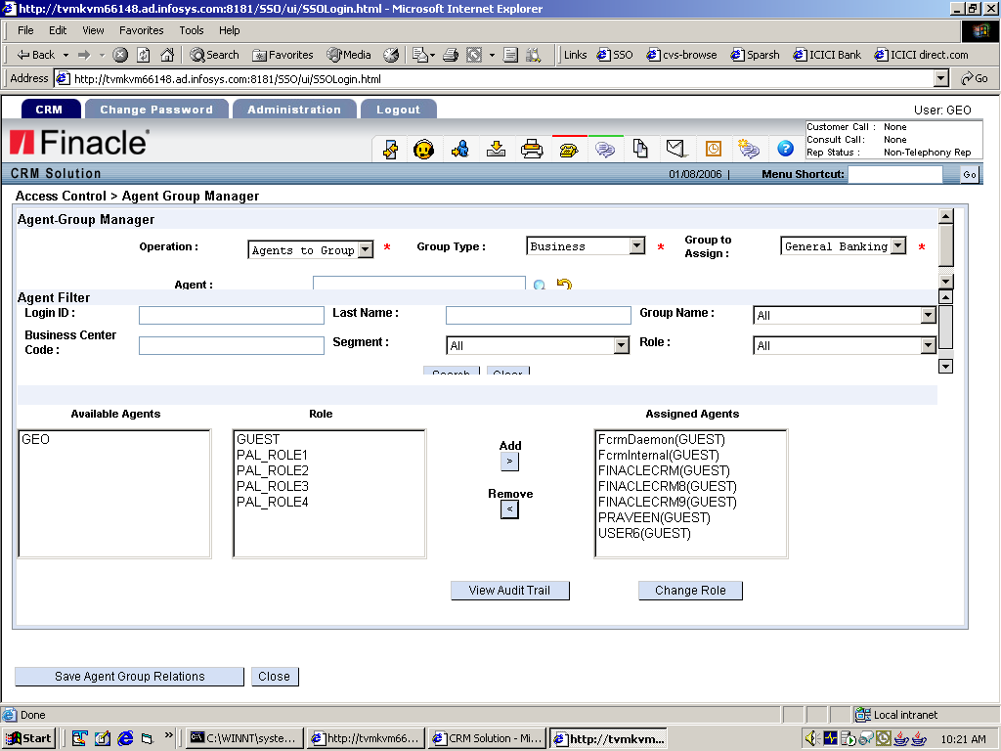
Agent Group Manager

Slide 12
Agent Segment Manager
Access Segment is a data category.
User can belong to multiple segment.

Slide 13
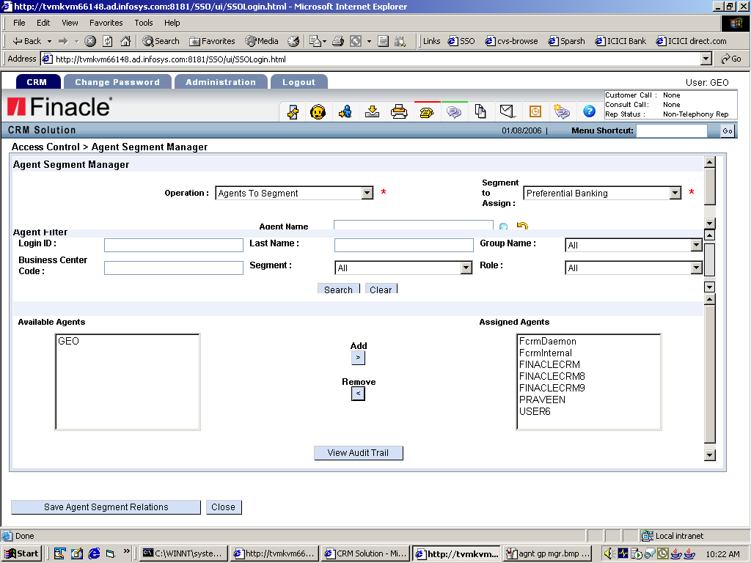
Agent Segment Manager

Slide 14
Role
Menu
Administration → Role
Role
Defines the access level of an agent in a group.
Users in a business group will have a role attached to them.
RCL→ Role
→ Access Matrix
→ Attribute Access

Slide 15
Access Matrix
  Each role is attached with an access matrix which defines the access of a role for a particular operation on a particular entiry.
    Access Entity
      INCIDENTS, PRODUCTS , SALES, OPPORTUNITIES, RET CUSTOMER, RET PROSPECT, RET NONCUSTOMER, RET CONTACT, CORPORATE
    Access Levels
      SELF, SUBORDINATE, BCG, CBCG, GROUP, SEGMENT, FULL
    → Operation
    → READ, EDIT

Slide 16
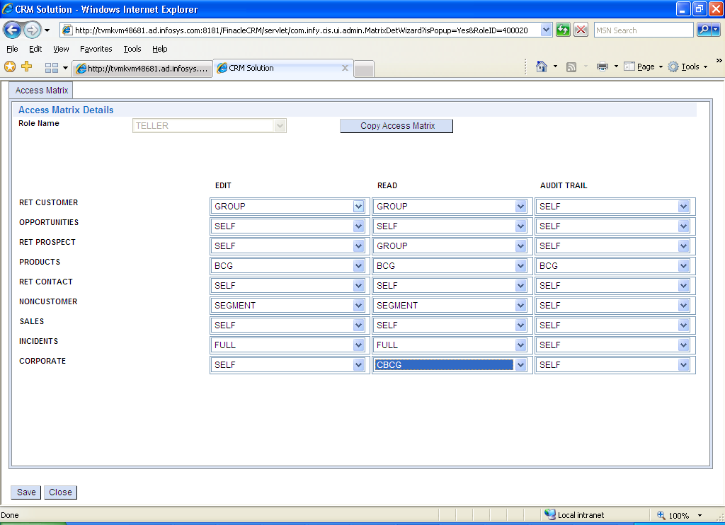

Slide 17

Access levels

Slide 18
Tray changes
No change in self tray.
Group drop down in group trays will list only those biz group in which user have access level above subordinate.

Slide 19
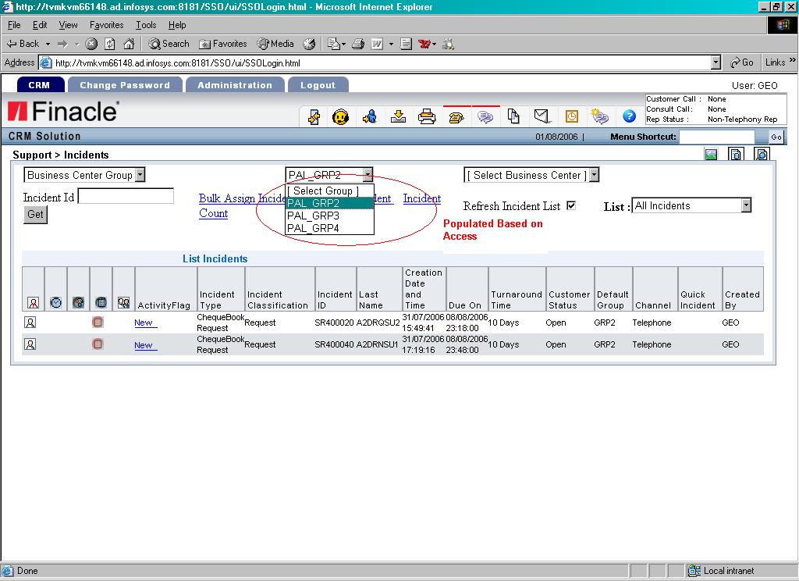
Tray changes

Slide 20
Attribute Access
Attribute access can be read only or deny.
Denied attribute will be masked in the screen
Readonly attribute will be disabled in the screen.

Slide 21
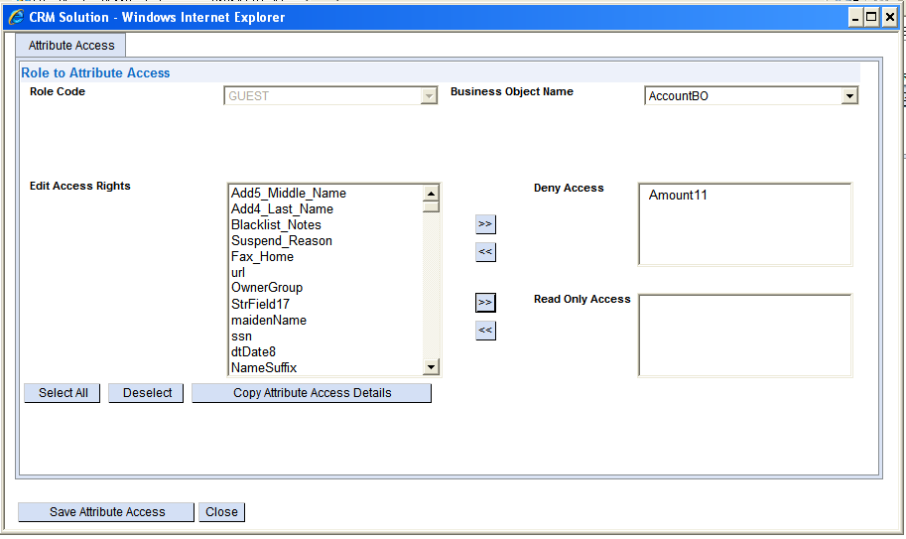
Attribute Access

Slide 22
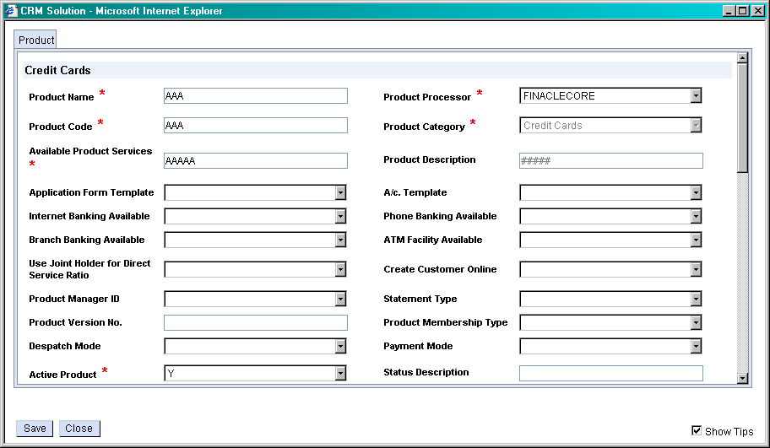
Attribute masking

Slide 23

Q & A

Slide 24

Thank You!

